Slide 1
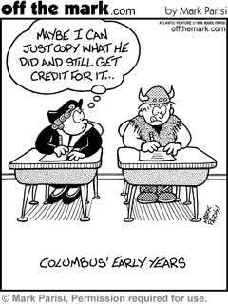

Slide 2
EQ: Who was in North and South America prior to Christopher Columbus “discovering” the Americas?

Slide 3
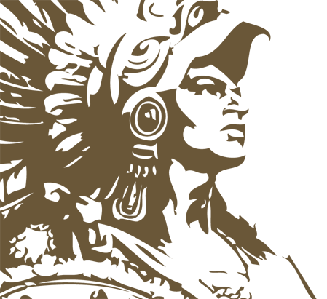
Pre-Columbian Americas
Chapter 1:
Sections 1-2

Slide 4
I. The Land Bridge Theory
A. Scientists believe that people came to the Americas around 15,000 to 40,000 years ago across the Beringia Land Mass.

Slide 5
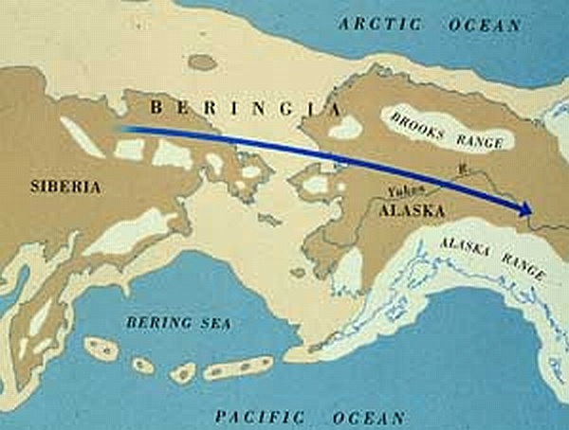
They possibly crossed land which connected Alaska and Russia during the Ice Age
1. more ice = less water in ocean = land exposed.
Notes:
Sea level may have been as much as 300 feet lower.

Slide 6
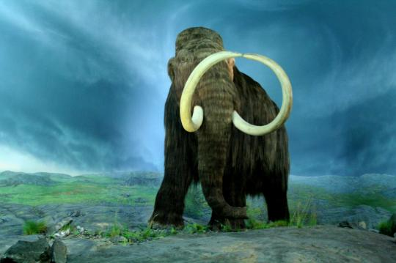
They were probably hunting large mammals and followed them to the Americas
- originally, these people were hunter-gatherers.

Slide 7
II. Early American Civilizations
Mesoamericans learned to farm around 10,000 years ago.
The Agricultural Revolution: Once they learned to farm, they quit wandering and began building civilizations.
Complex societies had formed by 1500 B.C.

Slide 8
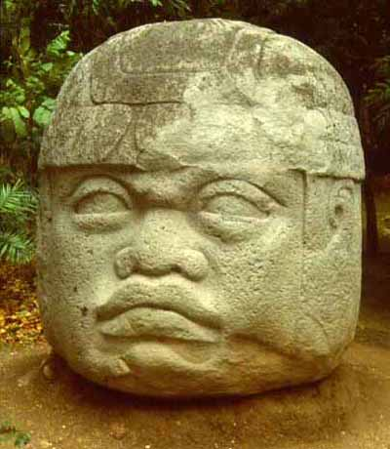
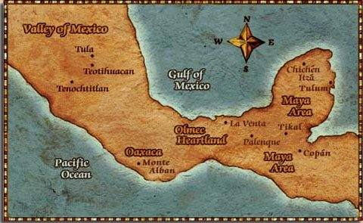
III. Civilizations in Central America
Olmec
1. near present day Vera Cruz, Mexico
2. trading empire
3. Believed to be the first to civilize.

Slide 9
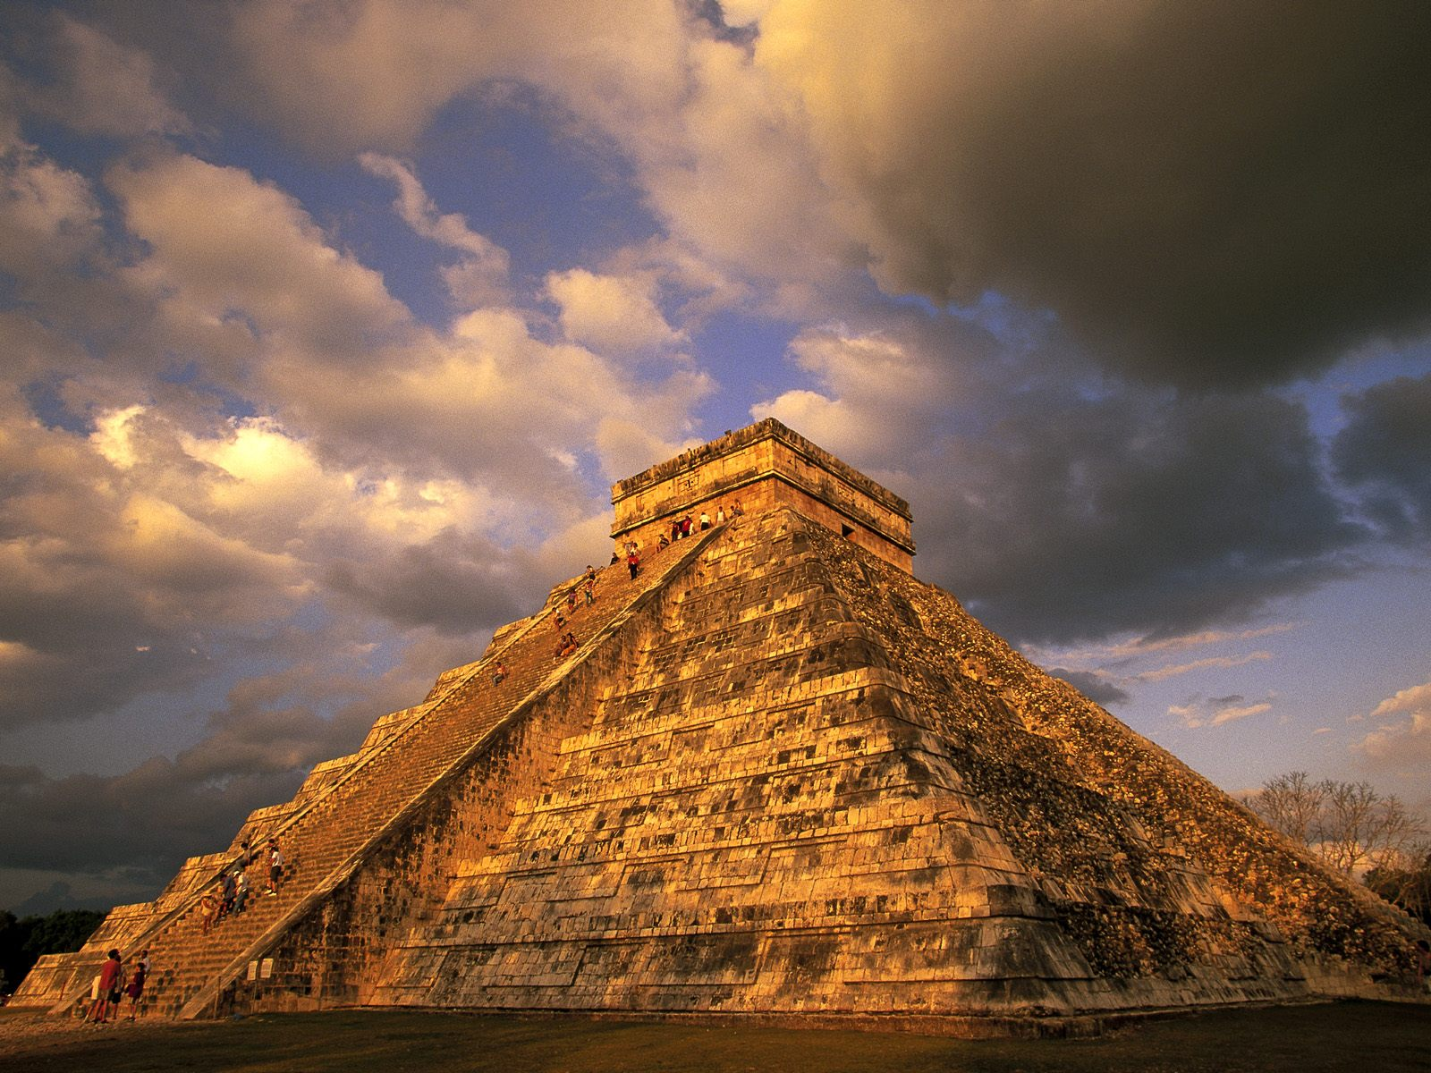
Notes:
Mayan ruins weren’t discovered until 1839

Slide 10
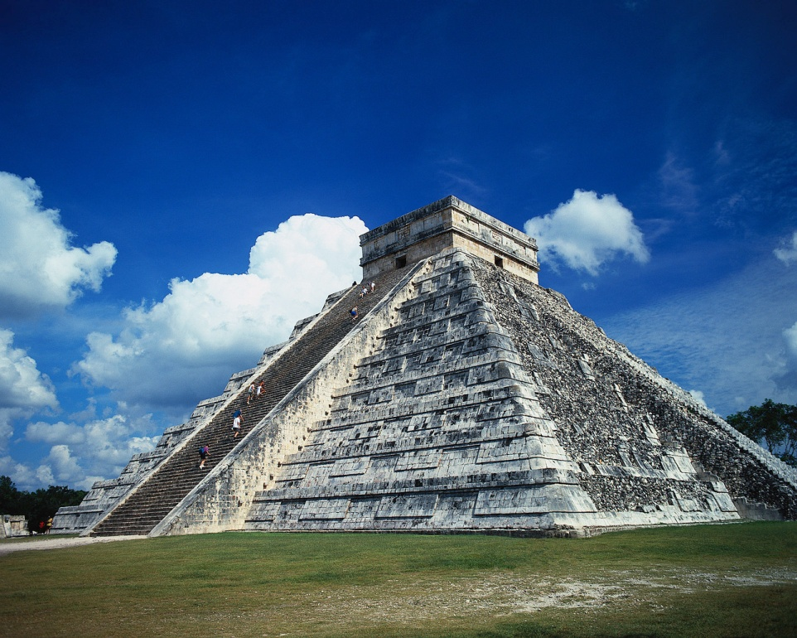
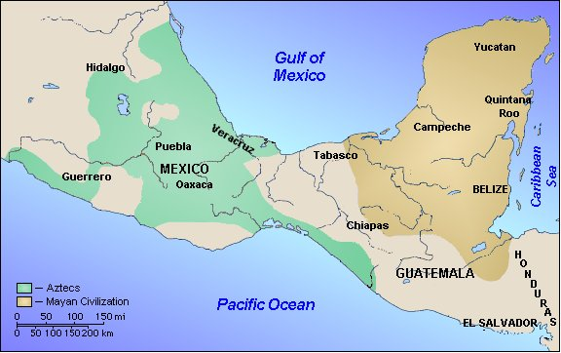
Maya
1. they were an empire on the Yucatan Peninsula.

Slide 11
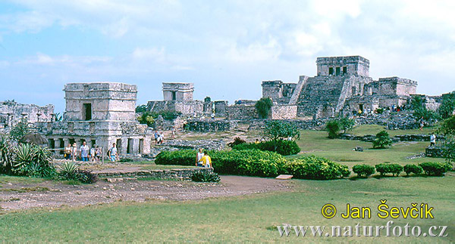
2. Mayans cities were a series of city-states, which often fought each other

Slide 12
3. Religion
- the temples were built on top of a pyramid.
- human sacrifices to the gods were common
Notes:
The Yucatan Peninsula has many sinkholes which are filled with water from underground rivers.
The Mayans believed that these sinkholes were a way to the gods, and would often throw human sacrifices down the sinkholes.
They believed that the gods gave them water, so they gave them back blood.
Priests had enormous

Slide 13
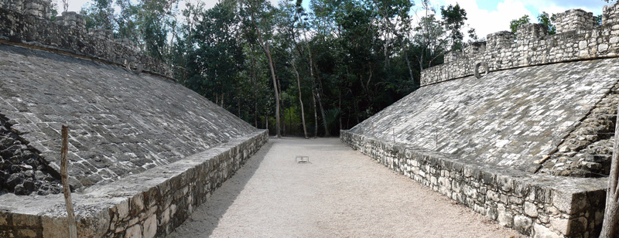

Slide 14
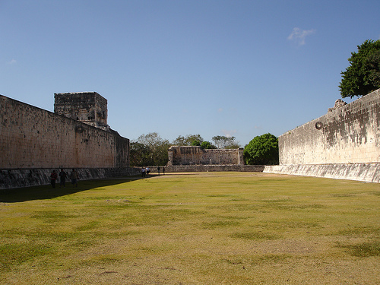

Slide 15
4. Science and language
- used astronomy to create a calendar
- they had a written language
Notes:
They tracked the movement of the sun, moon and stars – used the information to create a 365 day calendar
Written language similar to hieroglyphics

Slide 16
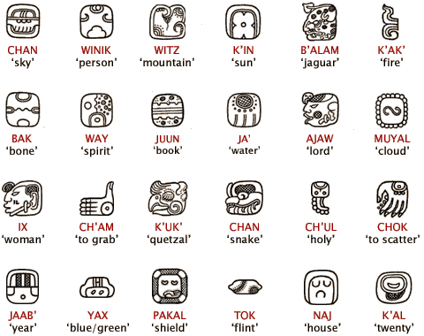

Slide 17
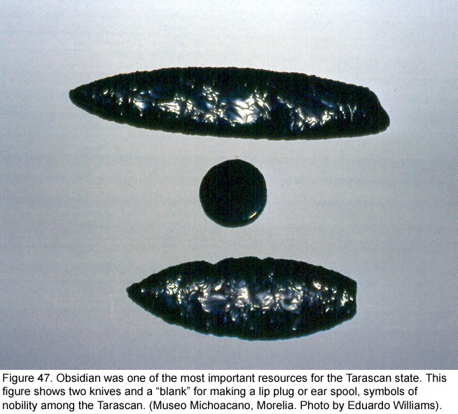
C. Toltec
1. lived in northern Mexico
2. warriors
3. used gold and silver for jewelry
4. Used obsidian for jewelry and weapons

Slide 18
D. Aztecs
1. The Aztecs built a huge empire, which included about 5 million people when Europeans arrived.
They were a warrior people – known for their military power.
Human sacrifice was very common in their culture.
Notes:
The Aztecs built a city called Tenochtitlan in the marshes near Lake Texcoco
The king led the men into battle.
You could become a nobleman by proving yourself in battle
Dying in battle meant you were honored in the afterlife.

Slide 19
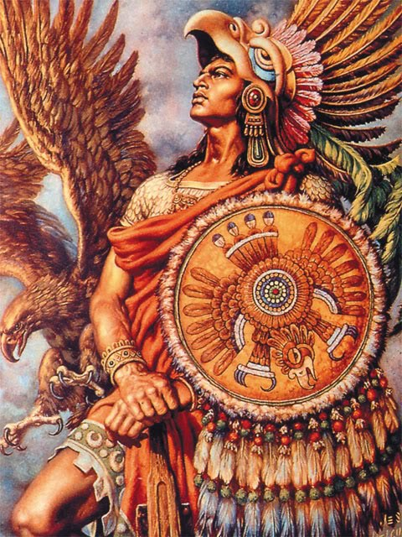

Slide 21
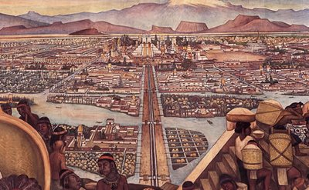
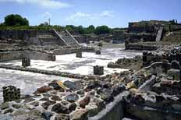

Slide 23
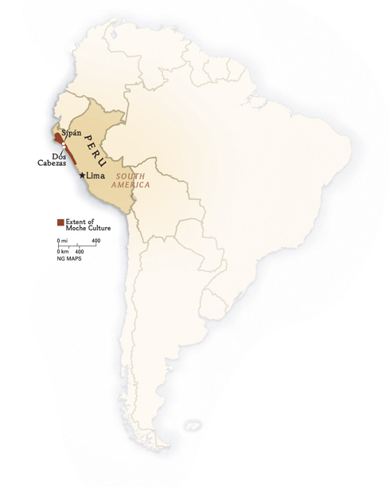
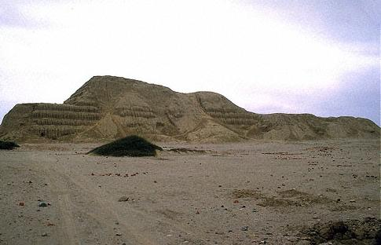
IV. Civilizations in South America
Moche
1. lived in dry coastal areas of what is now Peru
2. used irrigation

Slide 24
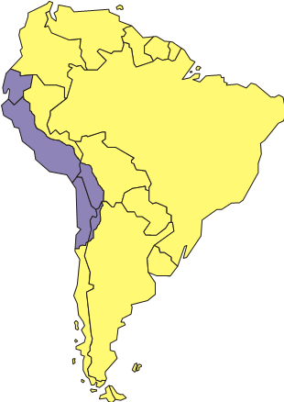
Incans
1. civilization on the west coast of South America in the Andes Mountains

Slide 25
2. The Incan Empire was the largest ancient empire in the Americas.
3. Incan society was very organized
1. had to learn a common language
2. trained future rulers in Cuzco
3. every person over 5 had a designated job.

Slide 26
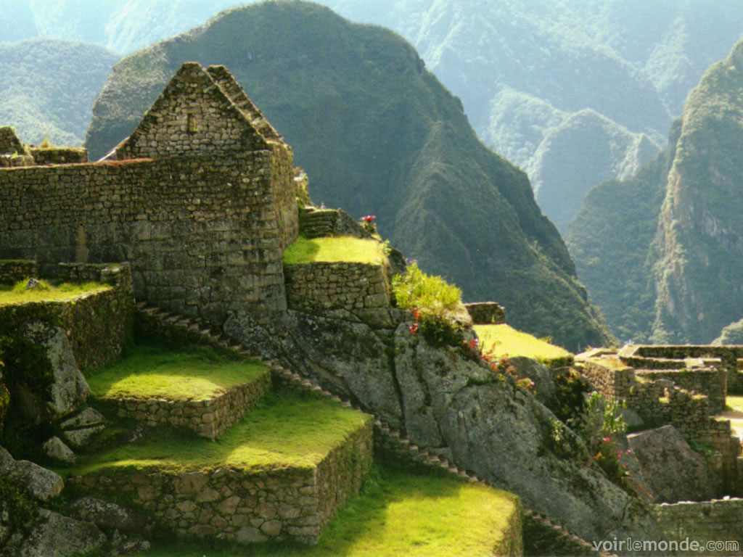
4. Machu Picchu is the most famous structure the Incans have left behind
Notes:
Macchu Picchu
Could have been a religious site
Could have been a retreat for kings
Very high in the Andes Mountains
they built their buildings out of granite with no mortar – this allowed the buildings to shift slightly during earthquakes, but would not often fall.

Slide 27
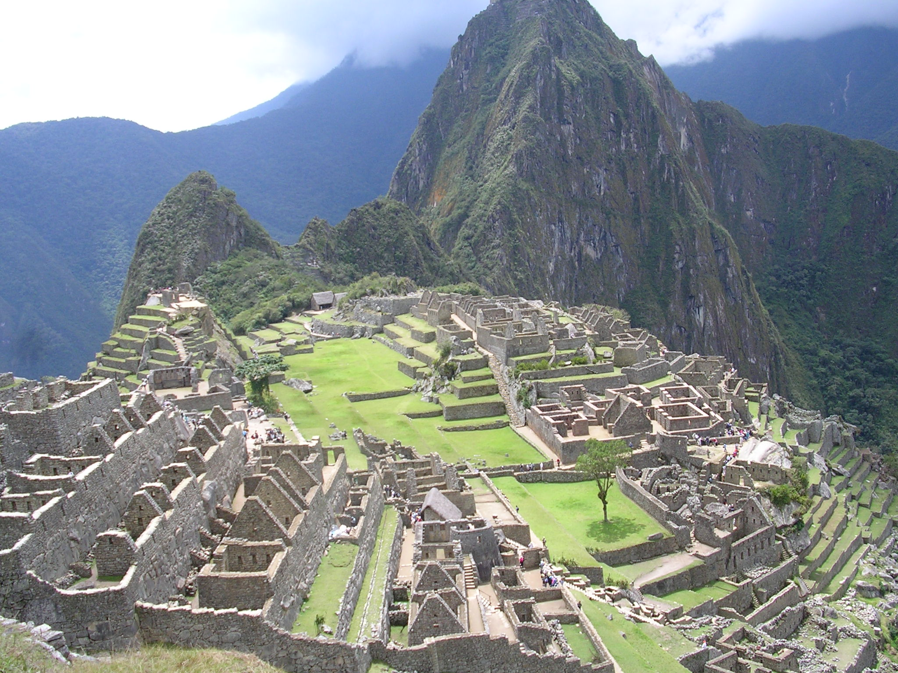

Slide 28
V. Civilizations in North America
Hohokam
1. farmers, created canal system
2. made jewelry from turquoise
Notes:
Located in what is now south central Arizona
Created a canal system diverting the water from the Gila and Salt Rivers

Slide 29
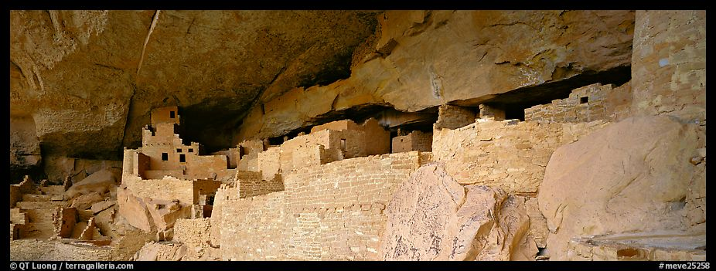
Notes:
Anasazi – “pueblo” dwellings

Slide 30
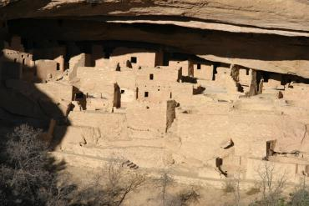
Anasazi
1. replaced the Hohokam
2. lived in houses built in cliffs, which the Spanish called pueblo.
Notes:
Located on the four corners area – Utah, Colorado, Arizona, and New Mexico
Chaco Canyon is probably the most famous example of the adobe/pueblo buildings

Slide 31
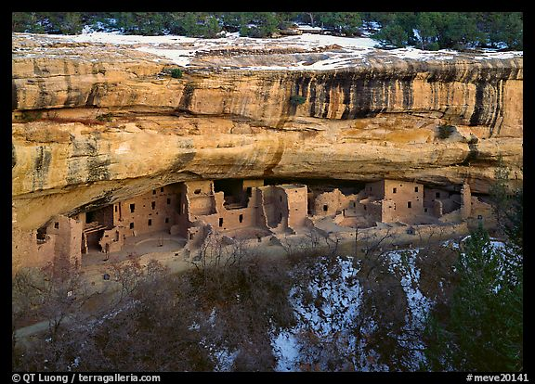

Slide 32
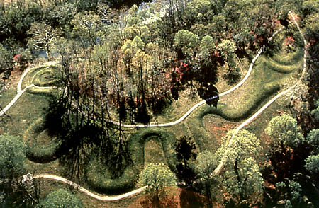
Mound Builders
1. lived east of the Mississippi River
2. built huge burial mounds that still exist today.
Notes:
Mound Builders include the Adena, Hopewell, Mississippians and others

Slide 33
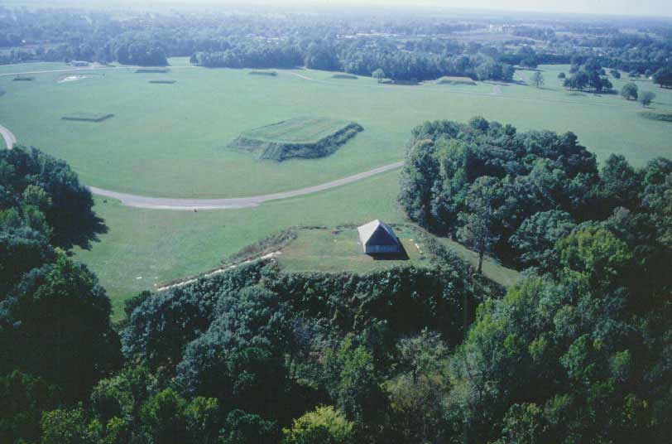

Slide 34
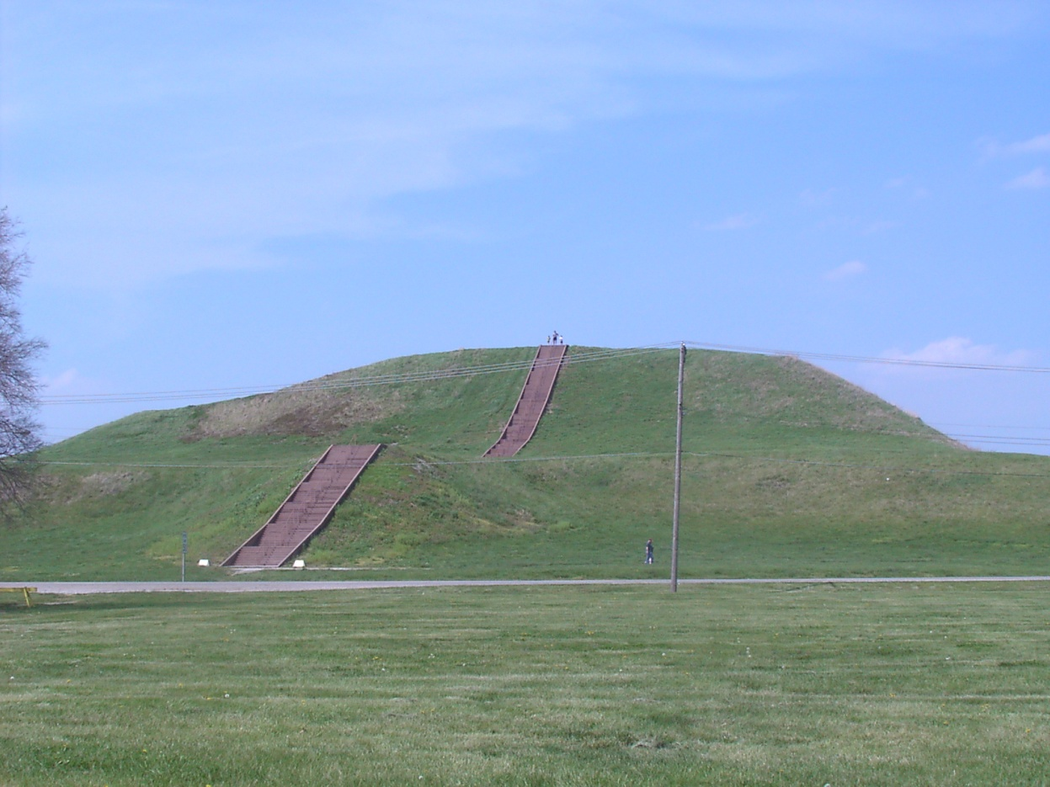
3. The Mississippians would often build mounds for their temples, or the homes of their leaders.
Notes:
The Creek and the Cherokee Indians were considered Mississippians and were common in Alabama and Georgia.

Slide 35
D. Algonquian
Used slash and burn agriculture
Believed that land was a resource for a group to use – not individual ownership
Notes:
Found in New England area, as well as Eastern Canada

Slide 36
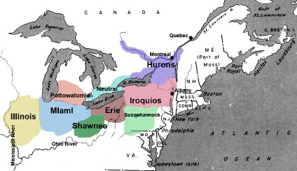
E. Iroquois
Formed the Iroquois League/Iroquois Confederacy to maintain peace
Chiefs on the council were selected by the women
Notes:
Found in the Great Lakes Area

Slide 37
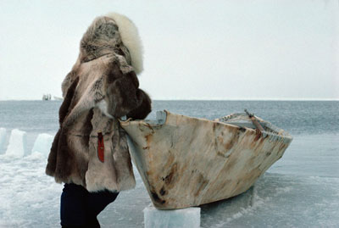
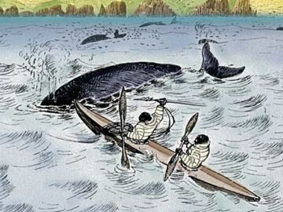
F. Inuit and Aleut
Depended heavily upon hunting
Sparsely populated
Inventions to deal with the climate: lamps, kayak, harpoons, snow shoes, and many more.
Notes:
Found in Alaska/ Northern Canada
Why do they depend heavily upon hunting? (poor agriculture – cold climate)

Slide 38
